Slide 1
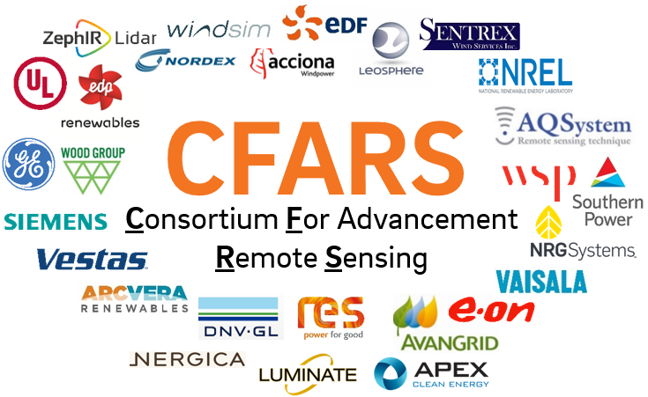
Site Suitability Subgroup – Preliminary Results of Benchmarking TI Bias
March 06, 2019
Alexandra St. Pé, E.ON
Nikhil Kondabala (APEX), Joseph Lee (NREL), Mithu Debnath (NREL), Zach Parker (Nordex), Luke Simmons (DNV GL), Ellie Weyer (UL), Scott Wylie (ZXLidars), Krystina Teoh (EDPR), Dale Apgar (GE), Thomas Fric (GE), Dan Michaud (GE), David Werner (GE), Darlene Gillis (Sentrex), Matthew Kennedy-Chevalier (RES), Jonas Asuma (Avangrid), Paul Mazoyer (Leosphere), Niels La White (Vaisala), Eowyn Baughman (Goldwind)

Slide 2
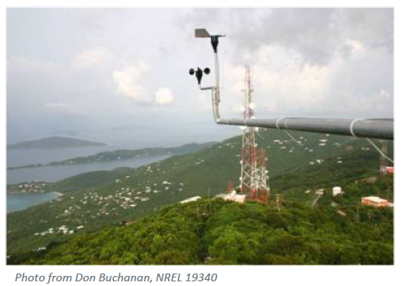
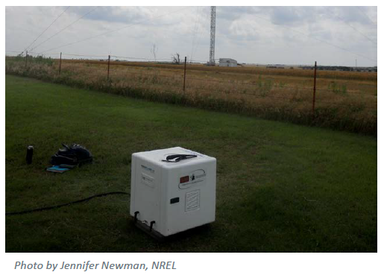

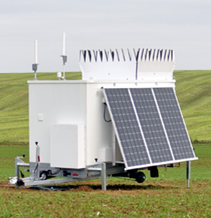
Background - TI
Challenge:
The industry is most familiar with cup or sonic anemometer TI measurements for turbine site suitability assessment – which are costly, fixed location, limited measurements by height
Solution:
RSD provides viable option, however measures TI different than cup or sonic anemometers (volumetric vs. point)
Notes:
Today, the industry is most familiar with cup anemometry for TI measurements for SS assessment… which can have their challenges due to high costs of installation and maintenance, but also their immobility and limited measurement by height– esp. when we considering a market with higher turbine HHs.
RSDs provide a solution to this challenge, as it they are mobile, can measure up to ~200m and above, however they measure TI different than cup anemometry, providing a volumetric estimate of TI, rather than a point measurement.
So while both cup and RSD TI measurements are “fruit” so to speak, one measurement is an apple the other an orange.
This fact can introduce challenges in interpretation of results if we try to use the apple’s methods with the orange data.

Slide 3


Decided there is value to build consensus along the easier path first…
Approach
RSD Corrected TI
RSD Raw TI
Research Question
What are the best
RSD TI correction methods?
What is the relationship between RSD volumetric TI and turbine design parameters/ suitability?
Research Question
Convert RSD into cup measurement for use in current OEM fatigue models
Refine current OEM fatigue models to receive RSD directly
Outcome
Outcome
Notes:
So keeping in mind the motivation of this group to increase acceptance of RSD for site suitability purposes, 2 major themes for approach emerged.
The first highlight in green reflects the direction the industry is already trending … Which is to correct RSD TI measurements to be more similar to trusted cup anemometry… And in this vein, the overarching question becomes what are the best methods to perform that correction?
The second approach highlighted in blue is a bit more pioneering…
It really gets to the crux of the matter by targeting the question of what is the relationship between RSD volumetric TI and turbine design parameters and suitability? SO how does RSD TI impact impacts fatigue loads on major turbine components (assuming it is different than cup TI).
This approach will require more time and thought on scope, and it would involve integration of RSD TI data into OEM tools so that we can build an evidence based understanding of the relationship.
When we look at these two approaches we prob all already agree that the easier path ahead is the one on the left, the RSD TI correction in simple terrain. But there are pros and cons to each approach, and I will live it up to this group to weigh those…
We as a group need to decide which path we think is more achievable or if we want to do both in parallel….
But I think it is important that for both approaches, we as a group engage with OEMs at the onset – to find out how best we can get RSD accepted for suitability and make sure our results are meaningful and transferable to their methods and models.

Slide 4
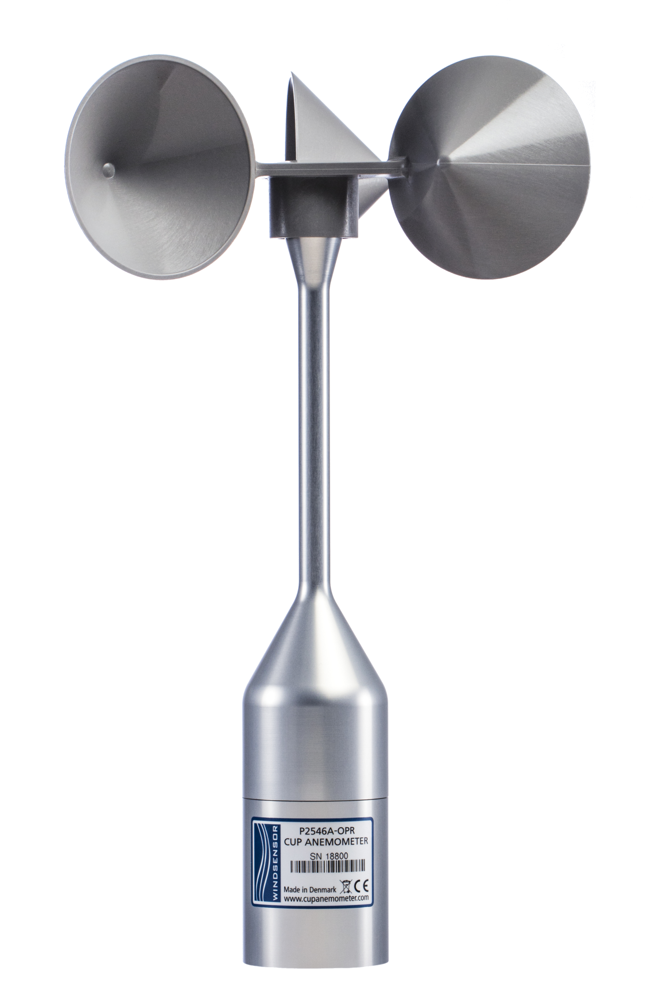
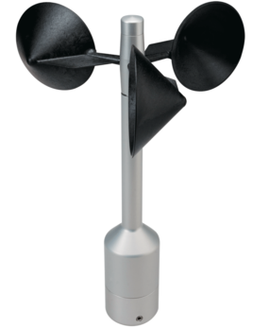
Phase 1 Test Approach – Benchmark TI Bias
- Organizations test average TI bias between their own RSD –mast collocated, concurrent, data:
Reference Anemometer TI vs. “Other” Anemometer TI
Raw RSD TI vs. Reference Anemometer TI
Corrected RSD TI vs. Reference Anemometer TI
&
&
vs.
Reference Anemometer TI
“Other” Anemometer TI
Reference Anemometer TI
Raw and/or Corrected
RSD TI
Notes:
This idea not new – see matt’ email from previous conference presentation..

Slide 5


Phase 1 Test – Hypothesis 1
Ane2 & Ref Ane TI Bias greater than Corrected RSD & Ref Ane TI Bias
&
&
≥
$${Ane2Ane_TI}_{Bias}$$
$${CorrRSD2Ane_TI}_{Bias}$$
Notes:
Help with justification of increasing our confidence of using RSD TI correction method; knowing we may not every perfectly reproduce the ane TI measurement.
Also allows us to establish a benchmark comfort level of acceptable TI bias with an anemometer with an RSD correction method applied. For example, let’s say we find that ane2 ane bias on average is around 15 % then we might say having a baseline RSD TI correction method without that range is good enough.

Slide 6
Phase 1 Test Datasets
Name | Organization | Key Information
 |  | Internal RSD Correction Method | Tower Distortion Filtering |  | # of Project Datasets | Terrain | Season | Available Wind Sensors | Heights
 |  |  | Method 1 | Method 2
Zach Parker | Nordex |  | x |  | 2 |  |  | Windcube V2, Triton Sodar, Thies (Ref & Ane 2), WindSensor (Ref), NRG #40 | 99m, 60m
Luke Simmons | DNV GL |  | x |  | 5 | Simple | Winter, Spring, Summer, Fall | Zephir300, Windcube V2, Triton Sodar, Thies, WindSensor | 80m, 90m, 93m
Dale Apgar | GE |  | x |  | 5 | Simple, Moderate | Winter, Spring, Summer, Fall | Windcube V2, WindSensor, Thies | 80m, 97m, 110m, 120m
Alexandra St. Pe | E.ON | x | x |  | 5 | Simple | Summer, Fall, Winter, Spring | Windcube V2, Thies, WindSensor | 60m, 80m, 100m
Matthew Kennedy - Chevalier | RES |  | x |  | 3 | Moderate, Complex | Spring, Summer, Fall | Triton Sodar, ZephIR, Windcube V2, Vector, Vaisala, Thies | 60m
Krystina Teoh | EDPR |  | x | x | 5 | Simple, Moderate | Summer, Fall, Winter, Spring | Triton Sodar, WindSensor, NRG #40C | 60m, 80m, 100m
Nikhil Kondabala | Apex Clean Energy |  | x |  | 4 | Simple, Moderate | Summer, Fall, Winter, Spring | Triton Sodar, WindSensor, NRG #40 | 60m
Ellie Weyer | UL |  | x |  | 3 | Moderate | Fall, Winter | Windcube V2, NRG #40C (Ref), Vector | 40m, 49m, 59m
Jonas Asuma | Avangrid |  |  | x | 1 | Moderate | Spring, Summer | Windcube V2, NRG #40c, NRG #40c (Ref) | 50m
Mithu Debnath, Joseph Lee | NREL |  | x |  | 1 | Moderate | Summer, Fall | Gailon Lidar, Metek Sonic | 50m, 80m
TOTAL |  | 1 |  |  | 34
Notes:
Min ~ 3 months of data. Asked for standard cleaning of data. And specific requirement of tower distortion.
Anemometer Icing - WS Outliers & Sensor Degradation
RSD Data Availability Check:
- RSD Low CNR - Valid wind directions for comparison chosen based on in-house mast flow distortion correction method

Slide 7
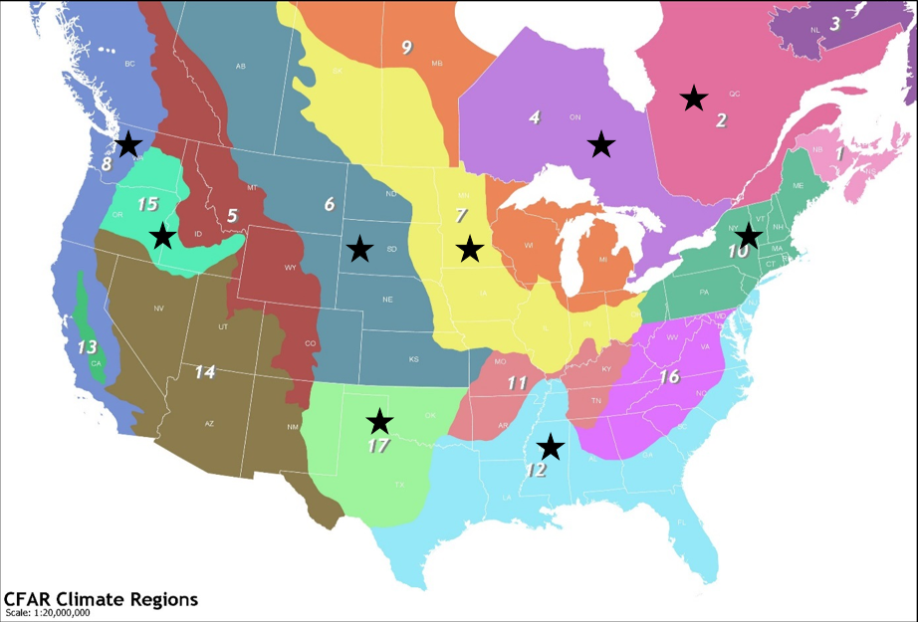
Phase 1 Test Datasets

Slide 8
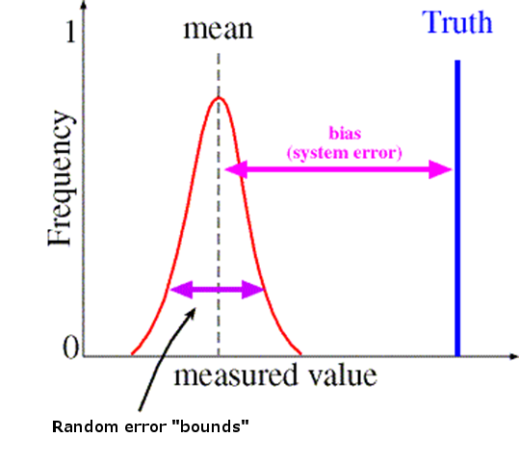
Phase 1 Test Methods – Performance Metric
Statistics Definitions Associated w/ Systematic Error
Mean Bias Error (MBE) is a measure of overall bias or systematic error.
It measures the average model bias, considering the error direction (overprediction vs. underprediction), thus positive and negative errors will cancel out.
Notes:
Needed a way to understand how far our average measurements were from the truth – in this case defined as the ref anemometer.
So we decided to use the statistics metric MBE which provides a measurement of overall systematic error or average model bias, considering the error direction, thus positive and negative errors cancel out.

Slide 9
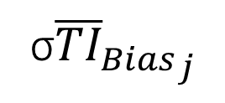

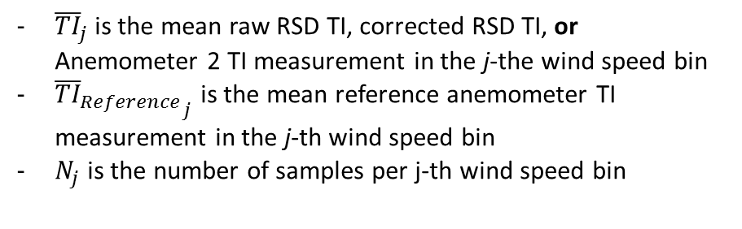
Phase 1 Test Methods – Performance Metric
Normalized MBE
${\overline{TI}}_{{Bias}_{j}} =$ $\frac{1}{N_{j}}\sum_{i=1}^{N_{j}}{\frac{{\overline{TI}}_{j}−{{\overline{TI}}_{Reference}}_{j}}{{{\overline{TI}}_{Reference}}_{j}}}$
TI MBE
- Calculate 0.5 m/s bin weighted average TI bias over a concurrent period using 10-minute average samples
Centered 0.5 m/s (e.g., 2 m/s bin = 1.75-2.25 m/s)
${\overline{TI}}_{j}$is the mean raw RSD TI, corrected RSD TI, or Anemometer 2 TI measurement in the j-the wind speed bin
${{\overline{TI}}_{Reference}}_{j}$ is the mean reference anemometer TI measurement in the j-th wind speed bin
$N_{j}$is the number of samples per j-th wind speed bin
Uncertainty
σ${{\overline{TI}}_{Bias}}_{j}$
Notes:
We decided as a group that there would be a lot of value for SS assessment and event PPTs studies if we quantify how TI bias changes across varies wind speeds, particularly those important loads assessment.

Slide 10
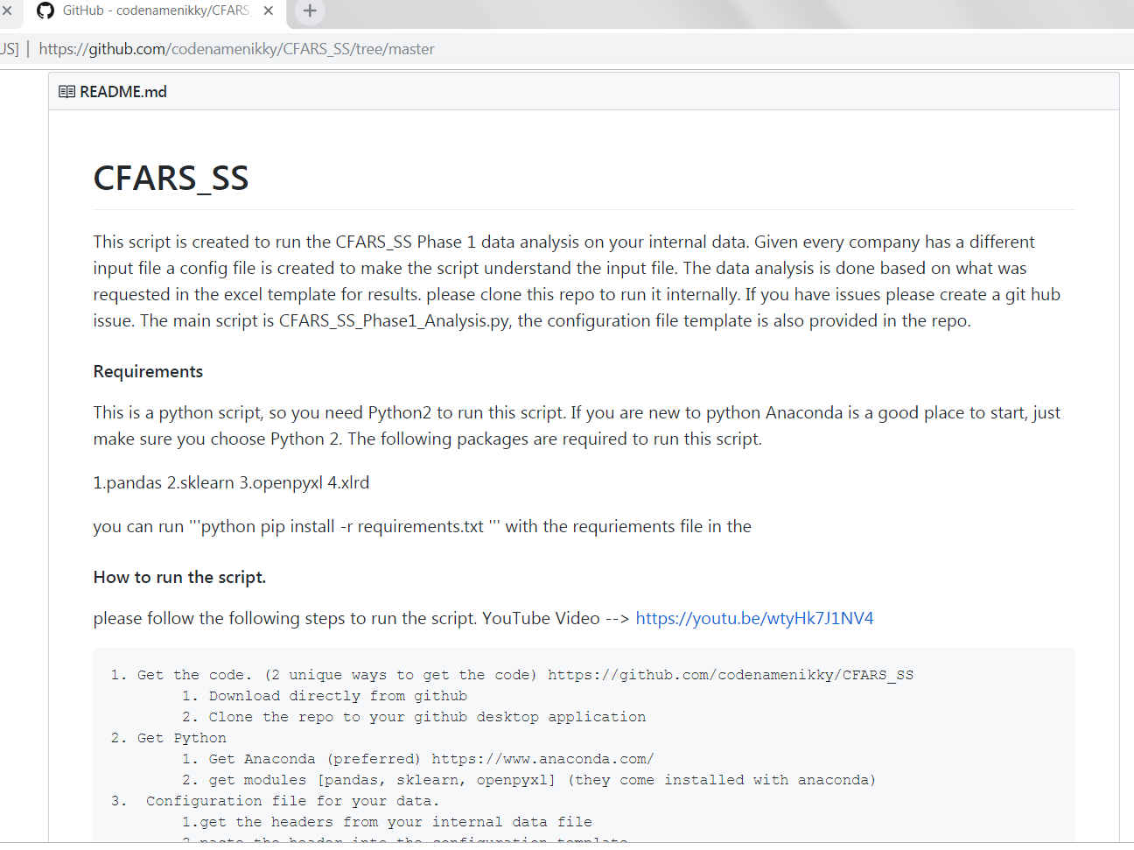
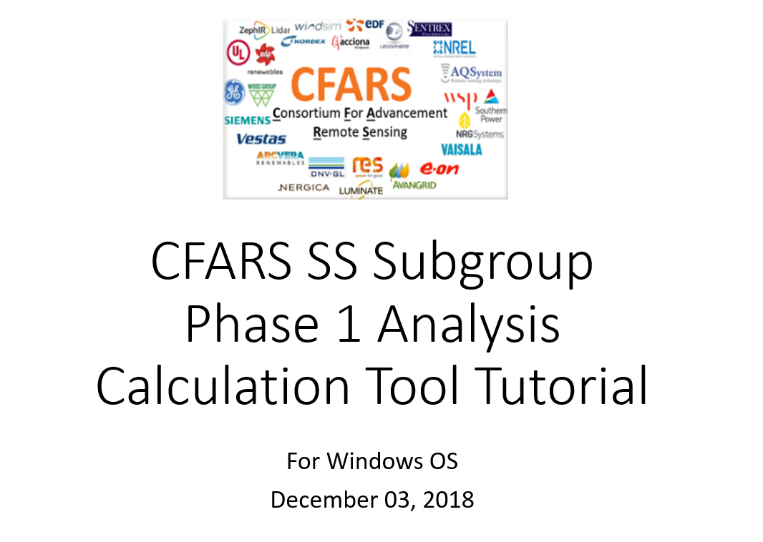
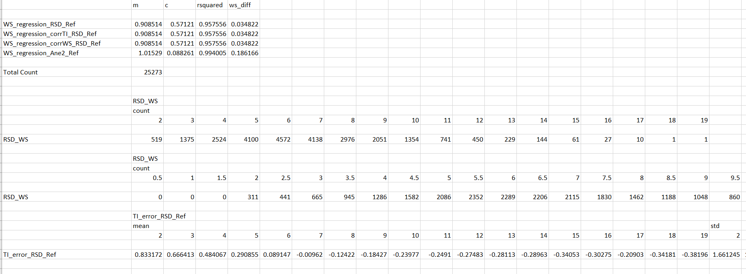
Phase 1 Test Methods - Analysis
2
1
Created opensource python code
https://github.com/codenamenikky/CFARS_SS/tree/master
3
Python code outputs excel file of results per project. This file shared amongst members.
Notes:
Truth be told, we started off trying to keep the work in excel given different backgrounds in programming…
however… as our ideas advanced on the stats we would like to see, we realized that we needed a more efficient way to run calculations and also eliminate possible user error in calcuations.

Slide 11
Phase 1 Test Preliminary Results
UL
Avangrid
E.ON
Nordex
RES
NREL
Lidar TI overestimate ~ ≤ 0.5 at lower winds
Lidar TI bias decreasing w/ increasing speeds
Bias uncertainty decreasing with increasing winds
Notes:
Submission date closed a few weeks ago. So these results are our first look at results. X axis wind seeped, Y axis TI MBE in decimal form; so multiple that number by 100 to get your percent. So 1 = 100%
First up is the lidar TI (Raw- so non corrected) vs. reference ane TI.
Keep in mind this plot is showing different lidars and different reference anemometers. We started to discuss as a group how best to group results without sending out the wrong message about TI measurement preference since our goal is really to create consensus on RSD TI correction methods. So at this stage, I have not grouped data more specifically. But this will be something the group does in some form in the future.
**Interpretation. Positive value → RSD overestimate TI compare to ane
Trends that slightly emerge:
Bias around 0.50 or less for all except the NREL project.. Mostly positive at lower ws.
A bit of good news, bias decreasing as we approach more critical speeds for site suitability, around 7- 14 m.s where TI bias can have the most significant impact on loads error since this is where we typically see the most turbine loading..
Uncertainty in each bin decreasing with increasing wind speeds (hard to see with black plot but focus on the colorful dashes you can slightly see it here)

Slide 12
Phase 1 Test Preliminary Results
EDPR
RES
Sodar TI overestimate ~ ≤ 1 at lower winds
Sodar TI bias decreasing w/ increasing speeds; demonstrates slightly underestimate of TI
Bias uncertainty decreasing with increasing winds
Apex
Nordex
Notes:
Next up is the sodar TI (Raw- so non corrected) vs. reference ane TI.
Trends that slightly emerge:
Sodar TI Bias a bit higher at lower wind speeds compared to lidar plot. But still mostly positive at lower ws.
Sodar bias becomes slightly negative at critical wind speeds.
For the most part, bias decreasing as we approach more critical speeds for site suitability, around 7- 14 m.s consistent with lidar prelim results.
Uncertainty in each bin decreasing with increasing wind speeds, consistent with lidar prelim results – except for EDPR data (hard to see with black plot but focus on the colorful dashes you can slightly see it here)
Caveats:
A couple of caveats here – some results yielded MBE greater than 1 as shown here, so we need to have a closer look to make sure those values are true and what’s driving the result.
Also, all sodars are Triton. Triton has just released or will very soon a new algo that provides an improved TI measurement.
So in the vein of keeping current with evolving tech, there may be value in re running the sodar tests with the new TI algorithm.

Slide 13
Phase 1 Test Preliminary Results
Anemometer 2 TI vs. Reference Anemometer TI
UL
Avangrid
E.ON
Nordex
RES
NREL
Apex
EDPR
TI MBE
Notes:
We started to look into whether E.ON data passing H1 is driven by the cup2cup TI Bias being unusually high…
And here is a first look at that investigation. What we see is that compared to others cup2cup comparisons, the 4 E.ON projects that pass H1 do demonstrated larger bias than others…. Except for Cyan which is a Thies vs Thies comp.
Possible influencers:
E.ON/ Nordex data outliers are class 1 vs class 1 anemometer comparison. GE data is now shown yet, by Dale mentioned in some cases he saw this larger bias for his Windsensor vs. Thies comparison as well. So I think another hypothesis is forming that class 1 to class 1 ane bias could be higher than other ane comparisons? But we need more data to tell and while we need to keep this finding in mind, it is not the goal of our tests so we should be careful of messaging that.
But there are a range of possible other influences
Anemometer calibration issues
Varying project characteristics (region, climate, season, number of samples, distance RSD to mast, etc)
Cleaning/tower distortion
So I think its important as a group, to the extent possible, we eliminate any drivers of bad quality input data to the tests for Phase 1 analysis.

Slide 14

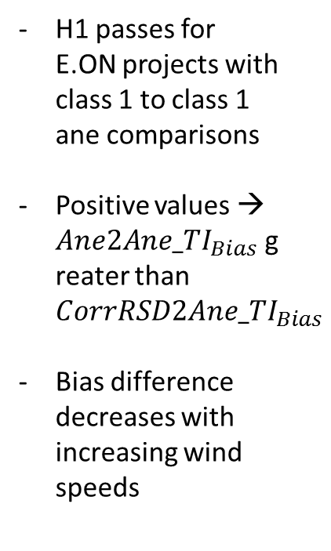
Phase 1 Test Preliminary Results
H1: Ane2 & Ref Ane TI Bias greater than Corrected RSD & Ref Ane TI Bias
Project 1
H1 passes for E.ON projects with class 1 to class 1 ane comparisons
Positive values → ${Ane2Ane_TI}_{Bias}$greater than ${CorrRSD2Ane_TI}_{Bias}$
Bias difference decreases with increasing wind speeds
Project 2
Project 4
Project 5
TI MBE Difference:
|${Ane2Ane_TI}_{Bias}| −|{CorrRSD2Ane_TI}_{Bias}|$
Notes:
Recall that H1 is that MBE between two anemometers is larger that MBE between corr RSD and anemometer.
So far, only EON has submitted RSD corrected data, and here are the results
Y axis is TI bias difference between the absolute value of each comparisons bias. Where positive values represent ane to ane bias is greater RSD. Absolute value taken since we’re dealing with neg pos MBE.
So interpretation help on the right, positive values are showing that the ane2ane TI bias is greater than corr RSD to ane bias.
For example,
Positive bc more error from cup to cup than RSD corr to cup. For example, project 2, abs value cup2cup bias 0.5 and abs value RSD cor 2 cup bias 0.1= 0.4 positive meaning cup to cup MBE is 0.40 larger. Negative values indicate that H1 failed (corrected RSD to cup bias larger than cup to cup).
And results show that indeed H1 passes for 4 of E.ON’s 5 projects ( all 4 projects are Windsensor vs. Thies comparison as we saw last May during the CFARS presentation at NREL). H1 failed on E.ON;s Thies vs. Vector project.
Interestingly, they also show that bias difference decreases as we increase in wind speeds (consistent with other plots), so bias differences decrease as we approach those more important wind speeds for loading.

Slide 15
Phase 1 Test – Preliminary Results Key Take Aways
RSD to anemometer TI bias and uncertainty generally lower at wind speed bins critical for loads assessment (~7-14 m/s)
RSD typically overestimate TI at lower wind speeds; but differences in RSD technology bias emerge at higher wind speeds → Best RSD correction method may vary by technology
Class 1 to Class 1 anemometer TI bias tends to trend slightly higher?
Lessons Learned:
Best to evaluate data from latest version of RSD retrieval
Can’t fully answer Hypothesis 1 without more RSD TI corrected datasets → Phase 2 tests should allow answer

Slide 16

Next Steps
Incorporate final few datasets – more Class 1 anemometer comparisons required!
New members welcomed for Phase 2 tests!
Need to agree on results grouping strategy (i.e., technology, project characteristics)
Conduct sensitivity study to determine valid min points per bin (esp. key bins for load assessment)
Convert TI bias into load error?
Incorporate lessons learned in development of Phase 2 tests (e.g., Code that cleans data? Confirms min bin count met? Code that cleans for tower distortion?)
Launch Phase 2 tests (ETA: May ‘19)
Notes:
- Incorporate final few datasets – more WS vs. This required!
Group results based on similar project characteristics
Convert TI bias into load error
Conduct sensitivity study to determine valid min points per bin (esp key bins for load assessment)
Incorporate lessons learned in development of phase 2 tests ( code that cleans data? Code that cleans for tower distortion ?)
Launch Phase 2 tests

Slide 17
Thank you. Questions?
(Alexandra.st.-pe@eon.com)

Slide 18
Extra

Slide 19
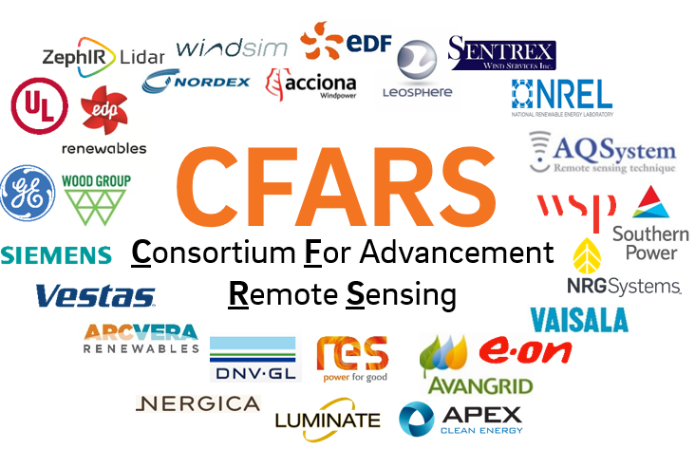
STATUS KEY PLANNING APPROVED DEVELOPMENT LAUNCH
2018 - Q3 |  |  | 2018 – Q4 |  |  | 2019 - Q1 |  |  | 2019 – Q2 |  |  | 2019 – Q3 |  |  | 2019 – Q4 |  |  | 2020 – Q1 |  |  | 2020 – Q1
JUL | AUG | SEPT | OCT | NOV | DEC | JAN | FEB | MAR | APR | MAY | JUN | JUL | AUG | SEPT | OCT | NOV | DEC | JAN | FEB | MAR | APR | MAY | JUN
Dataset Preparation
Phase 1 Analysis: TI Bias Benchmarking
Phase 2 Analysis: RSD TI Correction Method Evaluation
Baseline Best Practice RSD TI Correction Methods
Brainstorm on near-term group deliverables
Submission of Dataset Summary Stats Tables
Develop Dataset Summary Stats Template
Develop Python Opensource Tool For Calculation & Tool Guideline
Testing
Submission of Results
Summarize Results – White Paper
Develop Python Opensource Tool For Calculation & Tool Guideline
Testing
Submission of Results
Summarize Results – White Paper
Define & Align on Document Scope
Develop Document
Draft Document Released to internal CFARS for Feedback
Document Public Dissemination
CFARS Site Suitability Subgroup - Roadmap

Slide 20
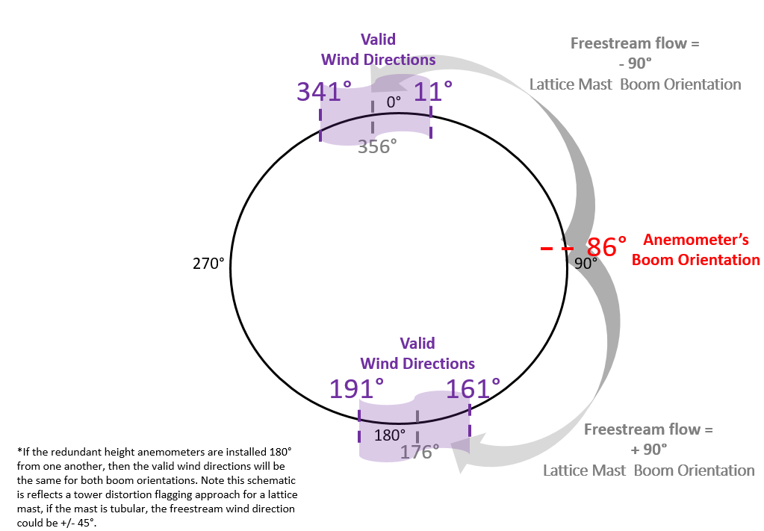
The Method 1 approach requires valid wind directions are established using boom orientation information from the anemometers. Specifically, for a lattice mast the valid direction sectors are wind directions across a +/- 15° wedge from the freestream flow of +/- 90° from the anemometer’s boom orientation. For example, if an anemometer’s boom orientation is 86°, then the valid wind directions to compare TI measurements would be 341°- 11° and 191° - 161°, as shown in Figure 1. Note if the redundant height anemometers are installed 180° from one another, then the valid wind directions will be the same for both boom orientations.
Note if the mast is tubular, the freestream wind direction could be ~ +/- 45°.

Slide 21
Phase 1 Test Preliminary Results
Apex
UL
E.ON
RES
TI MBE
Notes:
Submission date closed a few weeks ago. So these results are our first look at resulst.

Slide 22
Phase 1 Test Preliminary Results
Raw RSD vs. Reference Anemometer
Apex
UL
E.ON
Positive values → RSD overestimating TI compared to anemometer
Negative values → RSD underestimating TI compared to anemometer
RES
TI MBE
Notes:
Submission date closed a few weeks ago. So these results are our first look at results.

